Slide 1
Romans 15:1-13

Slide 2
15 We who are strong have an obligation to bear with the failings of the weak, and not to please ourselves. ² Let each of us please his neighbour for his good, to build him up. ³ For Christ did not please himself, but as it is written, “The reproaches of those who reproached you fell on me.” ⁴ For whatever was written in former days was written for our instruction, that through endurance and through the encouragement of the Scriptures we might have hope.

Slide 3
⁵ May the God of endurance and encouragement grant you to live in such harmony with one another, in accord with Christ Jesus, ⁶ that together you may with one voice glorify the God and Father of our Lord Jesus Christ. ⁷ Therefore welcome one another as Christ has welcomed you, for the glory of God.
⁸ For I tell you that Christ became a servant to the circumcised to show God’s truthfulness, in order to confirm the promises given to the patriarchs, ⁹ and in order that the Gentiles might glorify God for his mercy.

Slide 4
As it is written,
“Therefore I will praise you among the Gentiles,
and sing to your name.”
¹⁰ And again it is said,
“Rejoice, O Gentiles, with his people.”
¹¹ And again,
“Praise the Lord, all you Gentiles,
and let all the peoples extol him.”

Slide 5
¹² And again Isaiah says,
“The root of Jesse will come,
even he who arises to rule the Gentiles;
in him will the Gentiles hope.”
¹³ May the God of hope fill you with all joy and peace in believing, so that by the power of the Holy Spirit you may abound in hope.

Slide 6
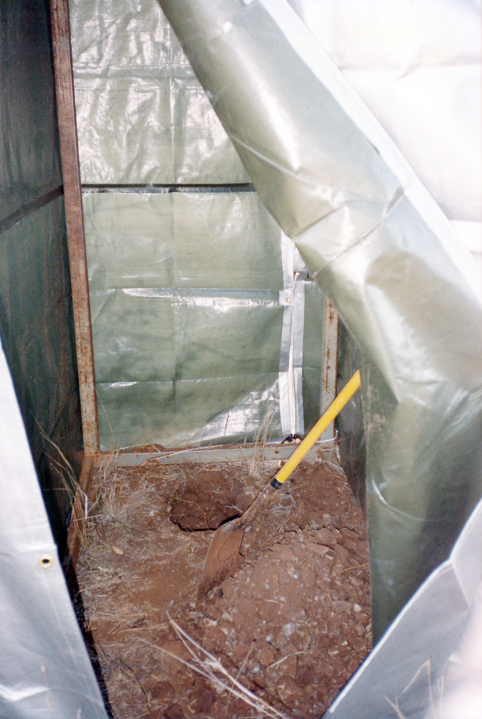
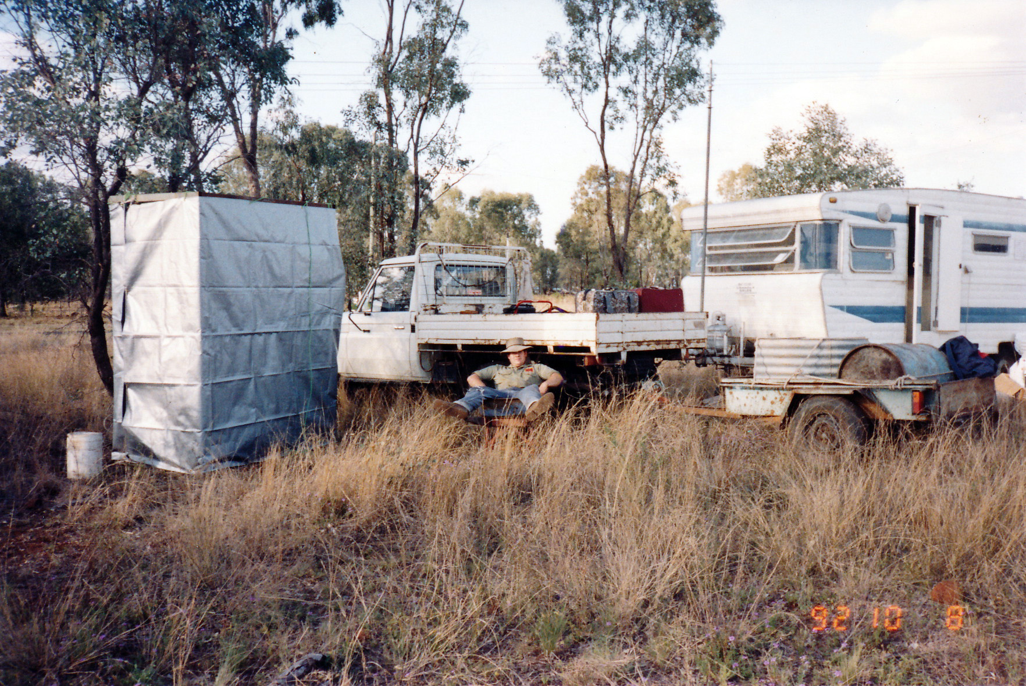
When you really love someone, you put up with a lot

Slide 7
When you really love someone, you’ll put up with a lot
1 Corinthians 13:⁴ Love is patient and kind; love does not envy or boast; it is not arrogant ⁵ or rude. It does not insist on its own way; it is not irritable or resentful; ⁶ it does not rejoice at wrongdoing, but rejoices with the truth. ⁷ Love bears all things, believes all things, hopes all things, endures all things.
⁸ Love never ends. …..

Slide 8
Enduring love – the harmony of Christian Discipleship
The grace of God leaves us with a debt
^{13:8} Owe no one anything, except to love each other, for the one who loves another has fulfilled the law.
^{15:1} We who are strong have an obligation to bear with the failings of the weak, and not to please ourselves. ² Let each of us please his neighbour for his good, to build him up.
“Love” means we don’t insist on our own way. We have an obligation to put our Christian brothers and sisters first.
God saves us by grace (totally free). But we are indebted to love each other, because that’s what the family of God does

Slide 9
Enduring love – the harmony of Christian Discipleship
God’s grace leaves us with a debt – to love each other
“Love” means we don’t insist on our own way. We have an obligation to put our Christian brothers and sisters first.
God saves us by grace (totally free). But we are indebted to love each other, because that’s what the family of God does
Jesus humbled Himself and became a servant of all
Disciples of Jesus follow the example of Jesus
Loving other Christians isn’t always easy.
The Scriptures are for our endurance and encouragement to keep on loving.

Slide 10
Enduring love – the harmony of Christian Discipleship
“Love” means we don’t insist on our own way. We have an obligation to put our Christian brothers and sisters first.
God saves us by grace (totally free). But we are indebted to love each other, because that’s what the family of God does
Jesus humbled Himself and became a servant of all
Disciples of Jesus follow the example of Jesus
Loving other Christians isn’t always easy.
The Scriptures are for our endurance and encouragement to keep on loving.
The Christian church is not an organisation where similar people meet to enjoy their similarities. It is a bunch of people with vast differences, who are thrown together by a common faith in the Lord Jesus Christ and the hope we have in Him
Love within the Christian church, is for the glory of God

Slide 11
Enduring love – the harmony of Christian Discipleship
“Love” means we don’t insist on our own way. We have an obligation to put our Christian brothers and sisters first.
God saves us by grace (totally free). But we are indebted to love each other, because that’s what the family of God does
Jesus humbled Himself and became a servant of all
Disciples of Jesus follow the example of Jesus
¹³ May the God of hope fill you with all joy and peace in believing, so that by the power of the Holy Spirit you may abound in hope.
Loving other Christians isn’t always easy.
The Scriptures are for our endurance and encouragement to keep on loving.
The Christian church is not an organisation where similar people meet to enjoy their similarities. It is a bunch of people with vast differences, who are thrown together by a common faith in the Lord Jesus Christ and the hope we have in Him
Love within the Christian church, is for the glory of God

Slide 12
Enduring love – the harmony of Christian Discipleship
“Love” means we don’t insist on our own way. We have an obligation to put our Christian brothers and sisters first.
God saves us by grace (totally free). But we are indebted to love each other, because that’s what the family of God does
Jesus humbled Himself and became a servant of all
Disciples of Jesus follow the example of Jesus
Loving other Christians isn’t always easy.
The Scriptures are for our endurance and encouragement to keep on loving.
The Christian church is not an organisation where similar people meet to enjoy their similarities. It is a bunch of people with vast differences, who are thrown together by a common faith in the Lord Jesus Christ and the hope we have in Him
Love within the Christian church, is for the glory of God

